Slide 1


Improving VQE accuracy for H4 molecule with shot limits
Quantum Information Challenge
Yunzhe Zheng

Slide 2
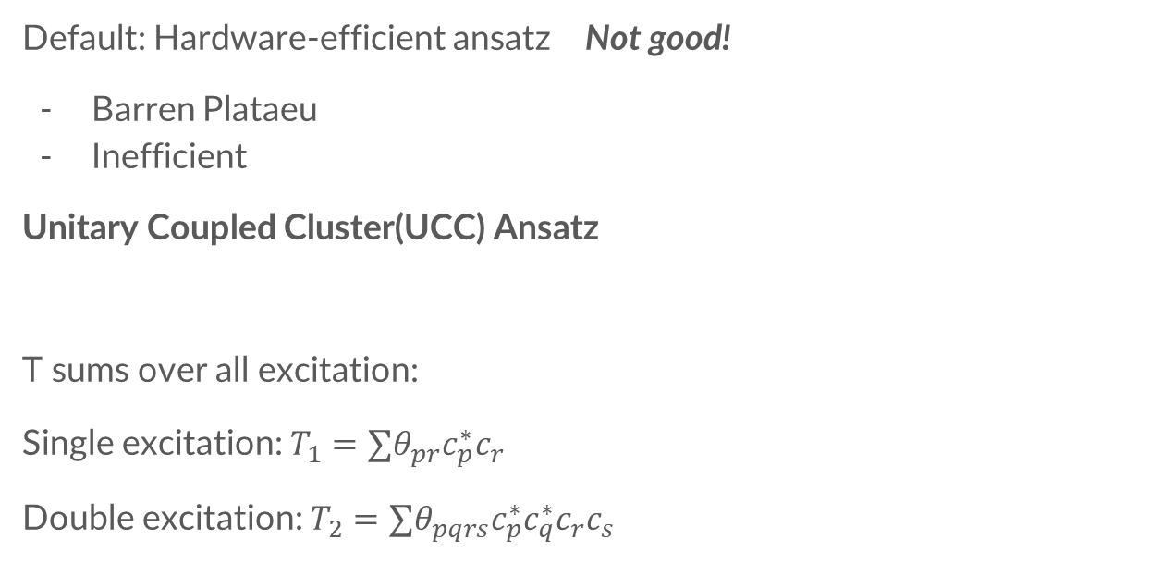



Ansatz
Default: Hardware-efficient ansatz Not good!
Barren Plataeu
Inefficient
Unitary Coupled Cluster(UCC) Ansatz
T sums over all excitation:
Single excitation: $T_{1}=∑θ_{pr}c_{p}^{∗}c_{r}$
Double excitation: $T_{2}=∑θ_{pqrs}c_{p}^{∗}c_{q}^{∗}c_{r}c_{s}$
$$U\left(θ\right)=\exp\left(T\left(θ\right)−T^{∗}\left(θ\right)\right)$$
$$T=T_{1}+T_{2}+…$$
Practically, $T=T_{1}+T_{2}$ is enough in our case.
p: occupied orbital. r: unoccupied orbital.
p & q: occupied orbital. r & s: unoccupied orbital.

Slide 3



UCCSD Ansatz
$$T_{1}=∑θ_{pr}c_{p}^{∗}c_{r}$$
$$T_{2}=∑θ_{pqrs}c_{p}^{∗}c_{q}^{∗}c_{r}c_{s}$$
How to express $U\left(θ\right)$ in circuit ansatz form? – Trotterization
Take n=1(A rough but practical choice)
Jordan-Wigner Transform:
$$U\left(θ\right)=\exp\left(T_{1}\left(θ_{1}\right)+T_{2}\left(θ_{2}\right)−h.c.\right)≈{\left[\exp{{\left(T_{1}\left(θ_{1}\right)−h.c. \right)}^{1/n}\exp{{\left(T_{2}\left(θ_{2}\right)−h.c.\right)}^{1/n}}}\right]}^{n}$$
$$U\left(θ\right)≈exp\left(T_{1}\left(θ_{1}\right)\right)\exp\left(−T_{1}^{∗}(θ_{1}\right)) ∗\exp\left(T_{2}\left(θ_{2}\right)\right)\exp\left(−T_{2}^{∗}(θ_{2}\right))$$
$$\exp\left(θ_{pr}c_{p}^{∗}c_{r}\right)=\exp\left(\frac{{iθ}_{pr}}{2}⊗_{a=r+1}^{p−1}Z_{a}Y_{r}X_{p}\right)$$
$$\exp\left(θ_{pqrs}c_{p}^{∗}c_{q}^{∗}c_{r}c_{s}\right)=\exp\left(\frac{{iθ}_{pqrs}}{8}⊗_{b=s+1}^{r−1}Z_{b}⊗_{a=q+1}^{p−1}Z_{a}\left(X_{s}X_{r}Y_{q}X_{p}+Y_{s}X_{r}Y_{q}Y_{p}+X_{s}Y_{r}Y_{q}Y_{p}+X_{s}X_{r}X_{q}Y_{p} −h.c.\right)\right)$$

Slide 4
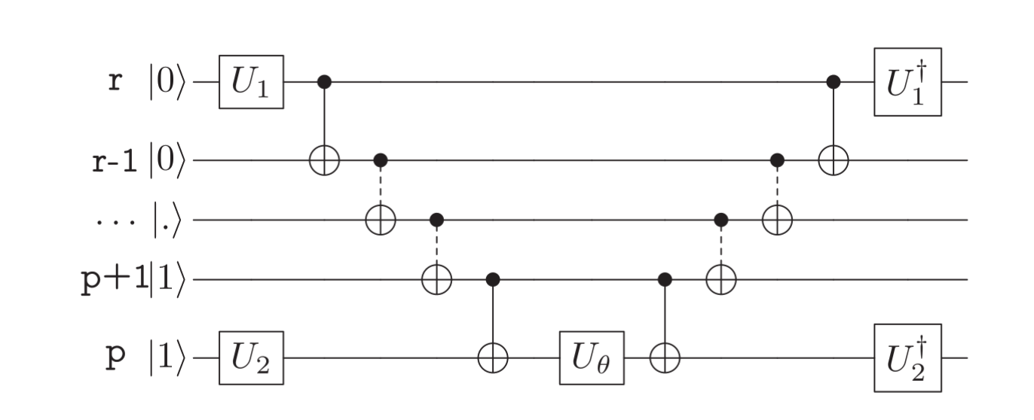

Single Excitation circuit
Repeat Twice for each excitation gate
Figure: Pennylane

Slide 5
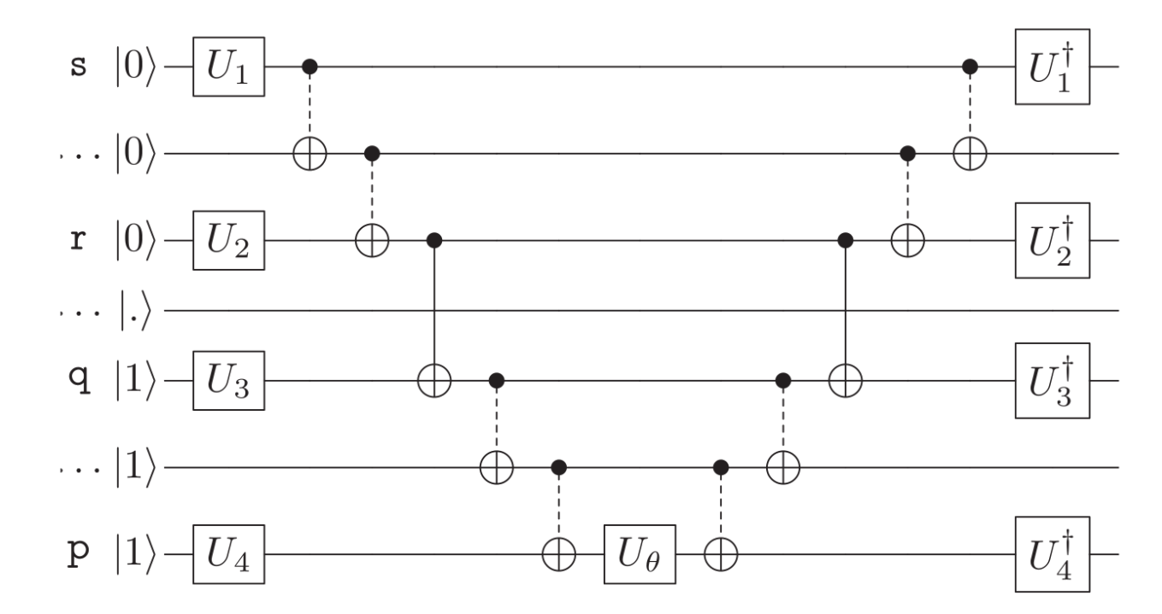
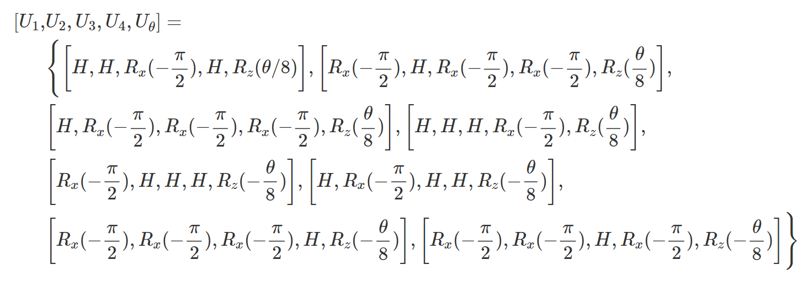
Double Excitation circuit
Repeat eight times for each excitation gate
Figure: Pennylane

Slide 6
Orbitals for H4
Single Excitation:
  - [0, 4] [0, 6] [2, 4] [2, 6] [1, 5] [1, 7] [3, 5] [3, 7]
  - 8 unique excitation
Double: - 16 unique excitation
Can be got from pennylane.qchem.excitations
α-spin
β-spin
6
4
2
0
7
5
3
1

Slide 7
Other Try
k-Unitary paired-Generalized Coupled Cluster Ansatz (k-UpCCGSD)
“Generalized”: consider all orbital combinations. Not distinguish occupied or unoccupied orbitals
“Paired”: only consider paired double excitation: both electrons in the same spatial orbital moved to another spatial orbital.
k=2(36 parameters) is sufficient for H4 to reach chemical accuracy*.
*https://arxiv.org/abs/2103.08505

Slide 8
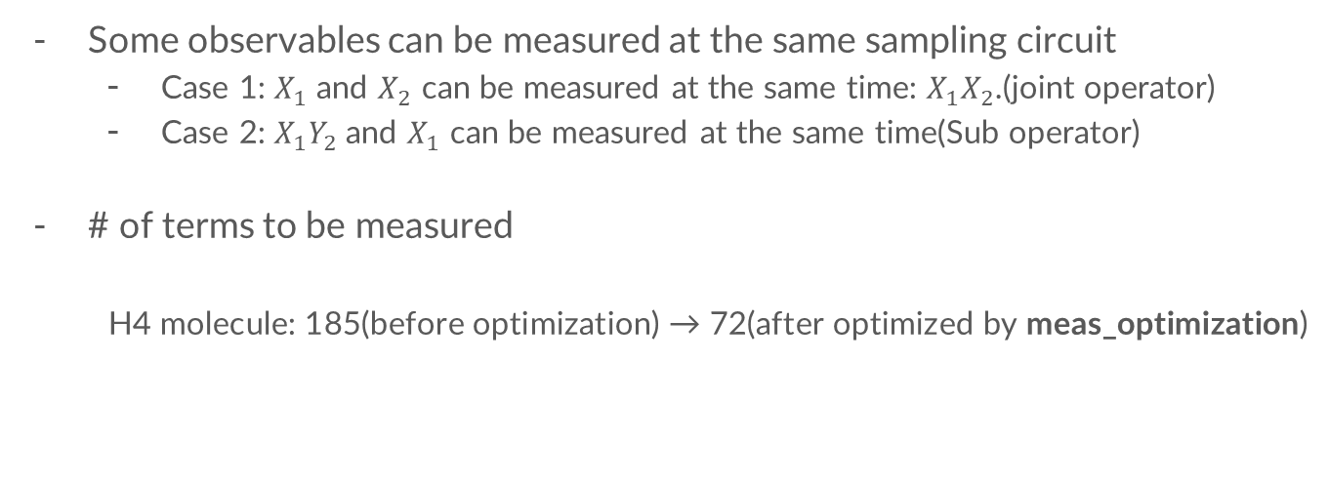
Measurement optimization: Operator Grouping
Some observables can be measured at the same sampling circuit
  Case 1: $X_{1}$ and $X_{2}$ can be measured at the same time: $X_{1}X_{2}$.(joint operator)
  Case 2: $X_{1}Y_{2}$ and $X_{1}$ can be measured at the same time(Sub operator)
# of terms to be measured
  H4 molecule: 185(before optimization) → 72(after optimized by meas_optimization)

Slide 9
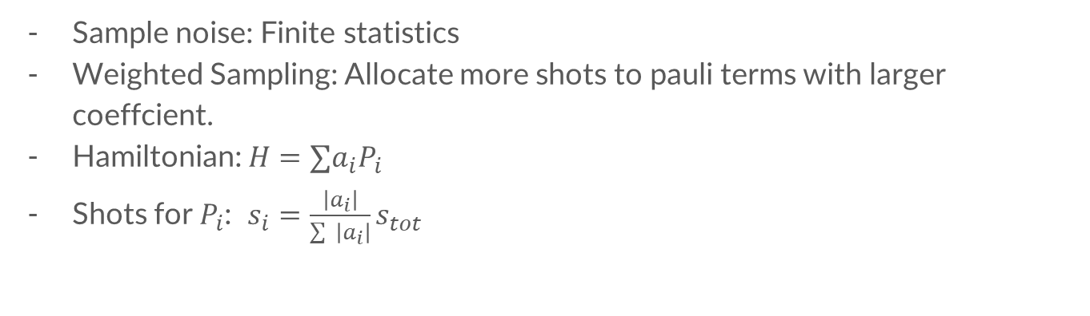
Measurement optimization: Weighted Sampling
Sample noise: Finite statistics
Weighted Sampling: Allocate more shots to pauli terms with larger coeffcient.
Hamiltonian: $H=∑a_{i}P_{i}$
Shots for $P_{i}$: $s_{i}=\frac{\left|a_{i}\right|}{\sum{ \left|a_{i}\right|}}s_{tot}$
Example: $H=0.5X_{0}+0.3Y_{0}+0.2Z_{0}$
The best way to minimize sample variation: 50% shots for $X_{0}$, 30% $Y_{0}$, 20% for $Z_{0}$.

Slide 10
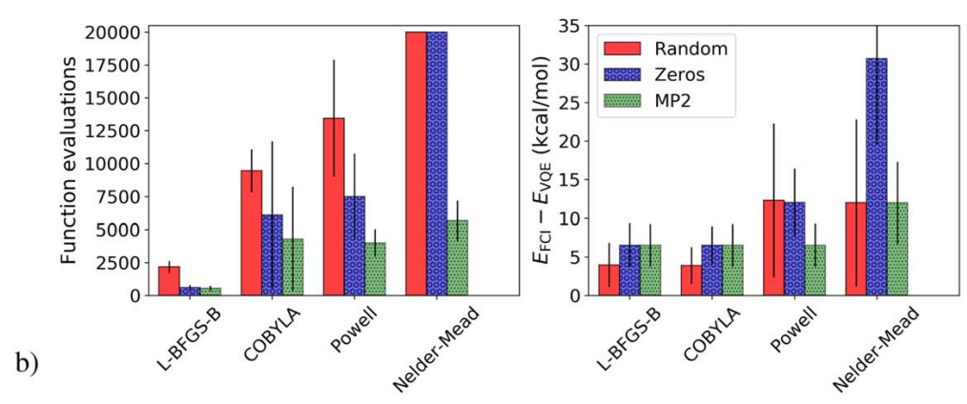
Optimizer - noiseless
L-BFGS-B: Limited-memory Broyden–Fletcher–Goldfarb–Shanno Bound algorithm
- Overperform COBYLA and Powell.
https://iopscience.iop.org/article/10.1088/2058-9565/aad3e4

Slide 11
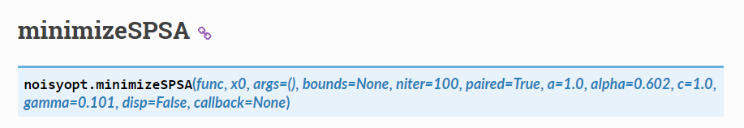
Noise-resistant optimizer
If we need to be more frugal:
Simultaneous perturbation stochastic approximation(SPSA)*
- Random Operator Sampling for Adaptive Learning with Individual Number of shots(Rosalin)**
*https://noisyopt.readthedocs.io/en/latest/api.html#minimizespsa
**https://arxiv.org/abs/2004.06252

Slide 12
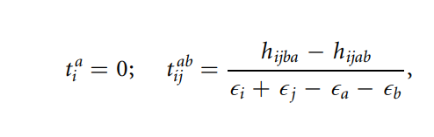
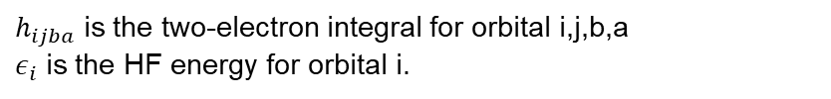
Parameter initialization
MP2 theory
SingleExcitation
DoubleExcitation
$h_{ijba}$ is the two-electron integral for orbital i,j,b,a
$ε_{i}$ is the HF energy for orbital i.
https://iopscience.iop.org/article/10.1088/2058-9565/aad3e4

Slide 13

Other try
Identity Block
Choose parameter $θ$, such that the whole starting ansatz is identity operation.
https://quantum-journal.org/papers/q-2019-12-09-214/pdf/

Slide 14
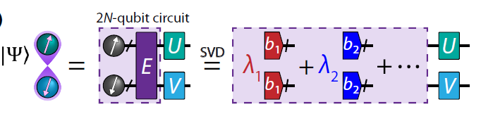
Using Symmetry
Qubit tapering(https://arxiv.org/abs/1701.08213)
Bipartite system(PRX QUANTUM 3, 010309 (2022))
Core idea: smaller system size with more terms to evaluate.

Slide 15




Error mitigation proposal
Mitigation with noise-estimation circuit(PRL 127, 270502 (2021))
Quantum devices suffer from depolarizing noise
Two-qubit gates are the main source of depolarizing error
The original paper is designed for quantum simulation, but the idea should also work for VQE.
Ansatz
Ansatz (only two-qubit gate)
Ansatz
optimizer
optimizer
$$⟨ψ(θ)|H|ψ(θ)⟩$$
Optimize θ
$${\left\langle ψ\left(θ\right)\left|H\right|ψ\left(θ\right)\right\rangle }_{noisy}$$
Noise: $p$
$${\left\langle H\left(θ,p\right)\right\rangle }_{miti}$$
Optimize θ

Slide 16
Result
We don’t implement all the ideas mentioned here. However, by UCCSD ansatz, weighted-sampling and measurement optimization, we reached quasi-chemical accuracy(~4mH).
If shot limit is 3~4 times larger, chemical accuracy can be reached(already tested).
Error mitigation approachs have not been implemented in code yet. But they can be easily packaged given the access to real noisy device.

Slide 17
I learned a lot during this Challenge.
Many thanks for your attention!

